Slide 1
Competition Task_Sprint2
Shreya Raina

Slide 2
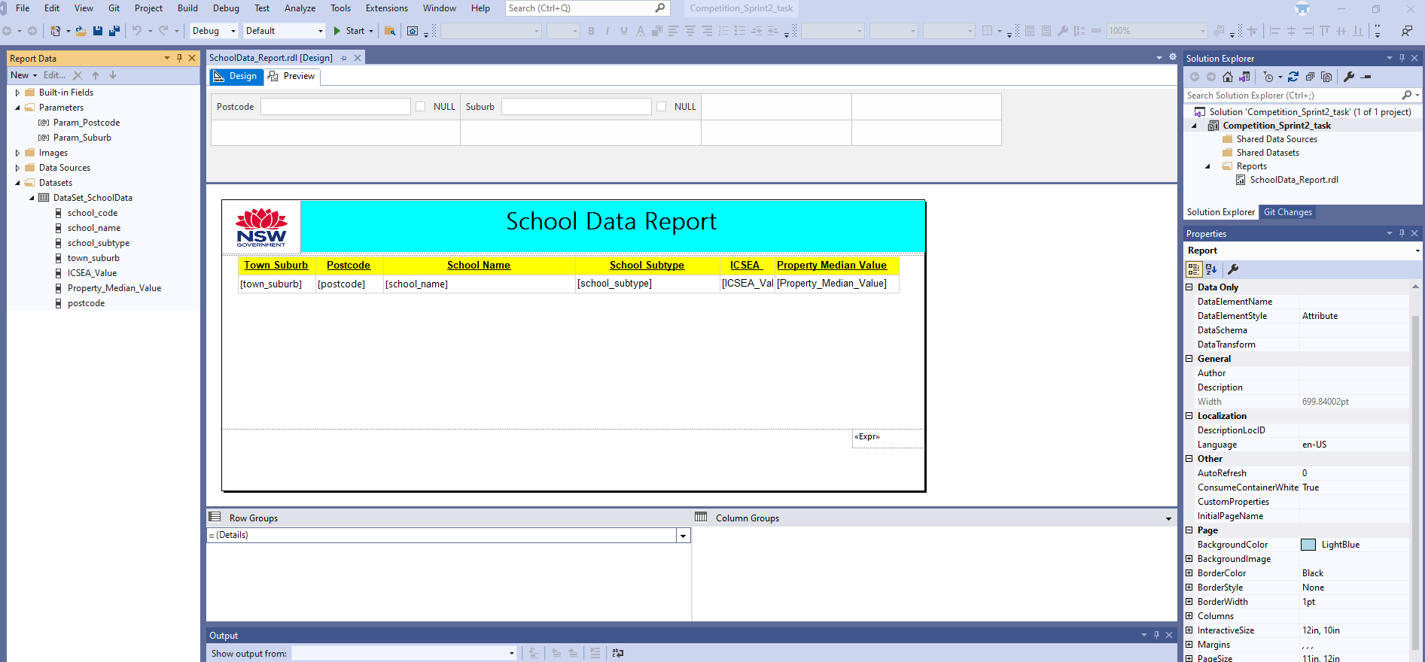
SSRS Report with details and parameters

Slide 3
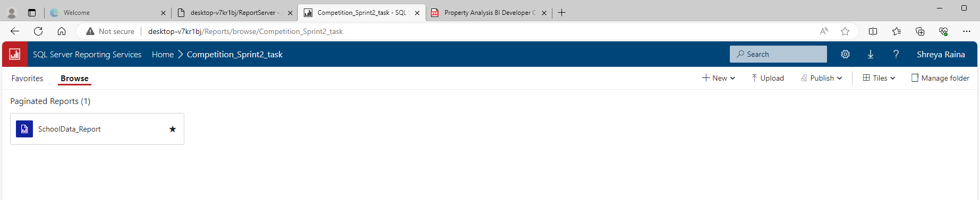
Published SSRS report into your web portal

Slide 4
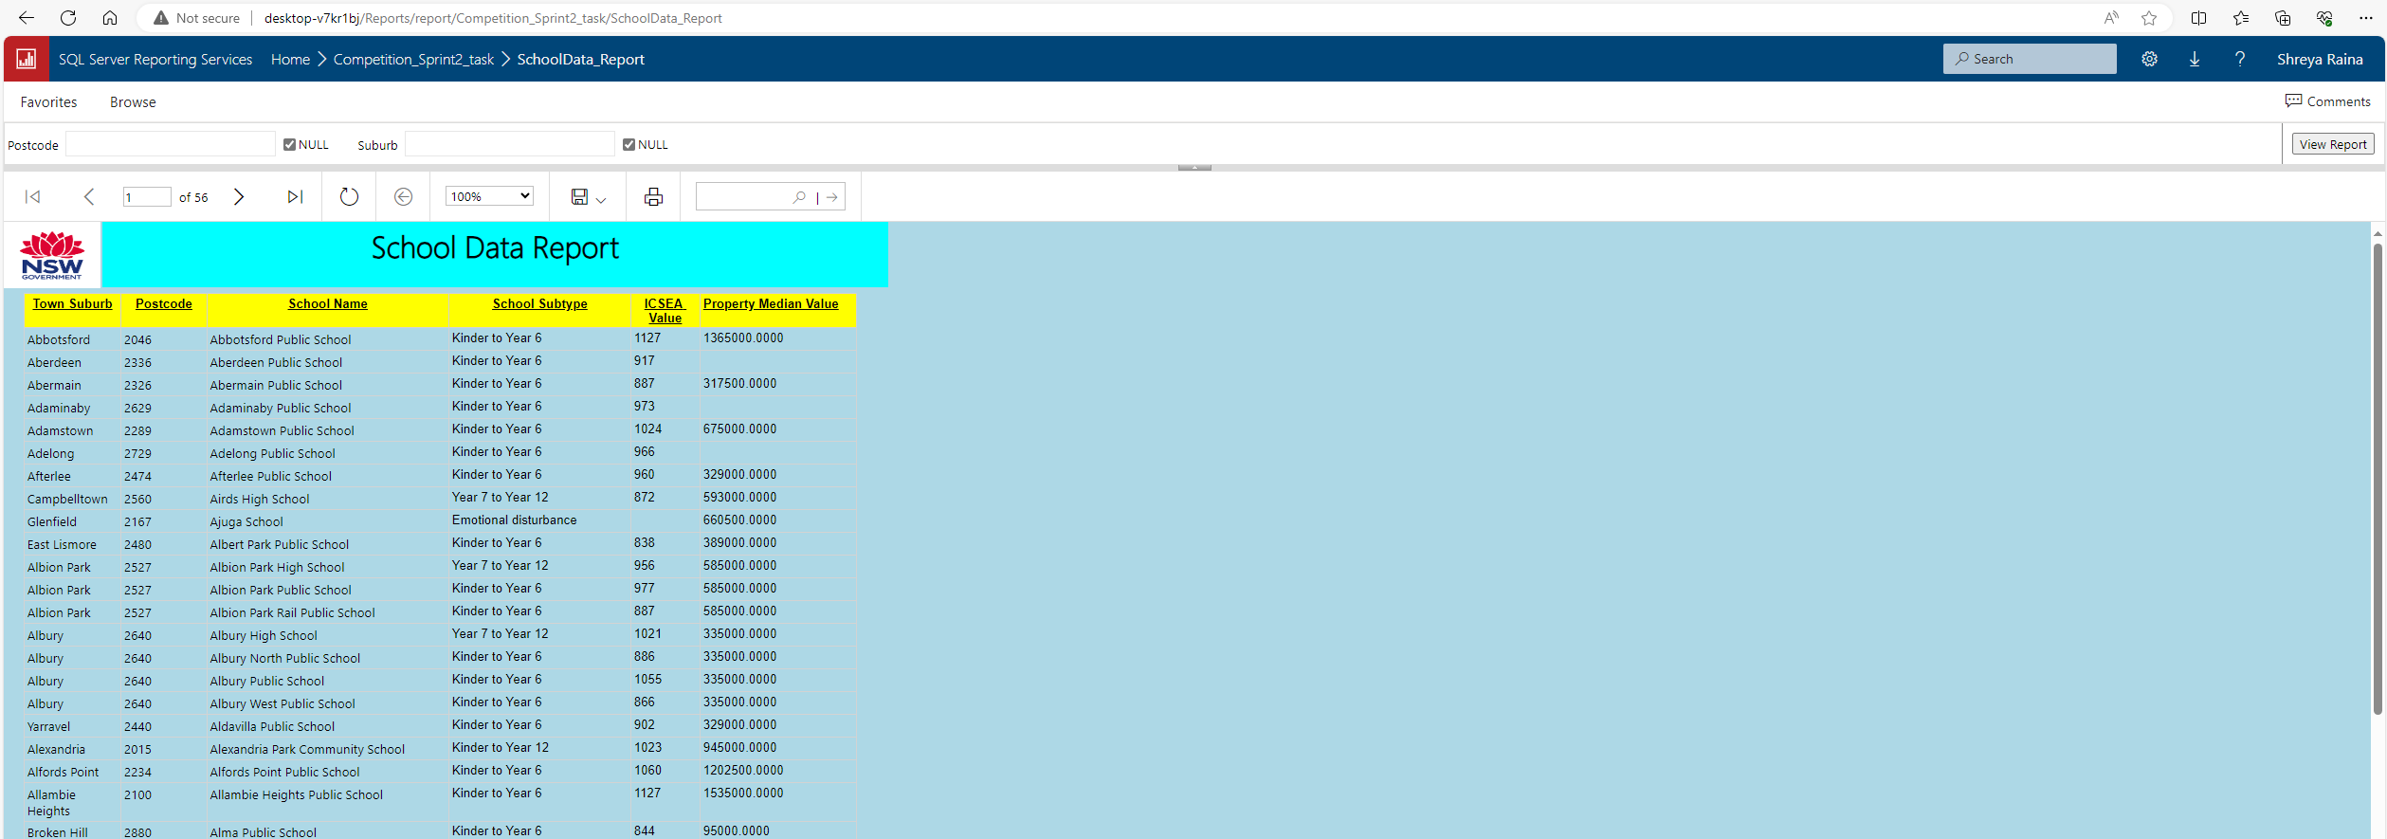
Report to be used by the user from web portal

Slide 5
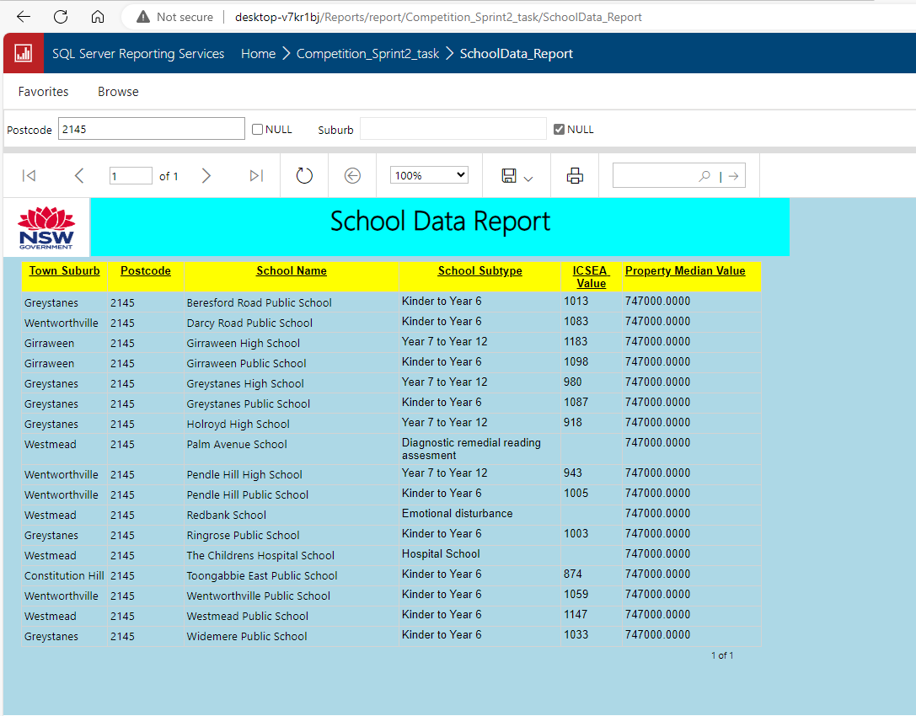
Drilling through Parameters on web portal

Slide 6
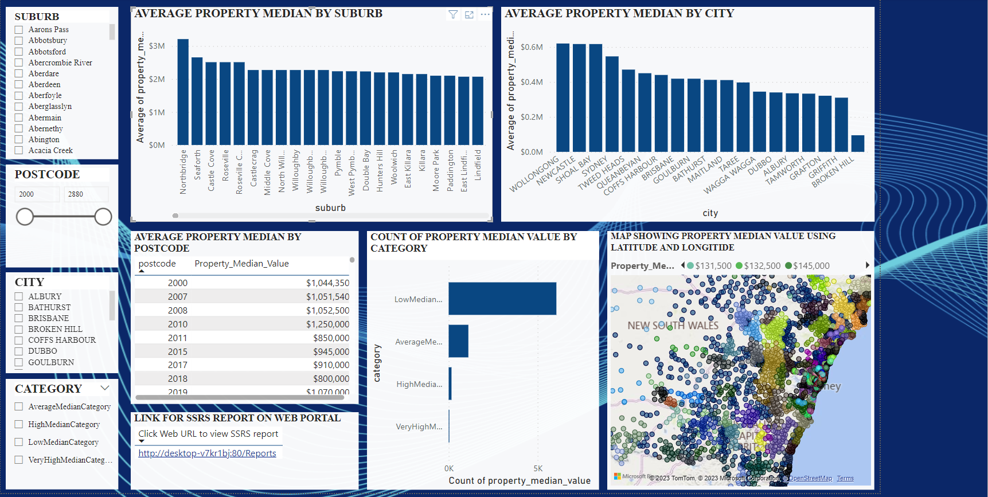
Power Bi Report

Slide 7
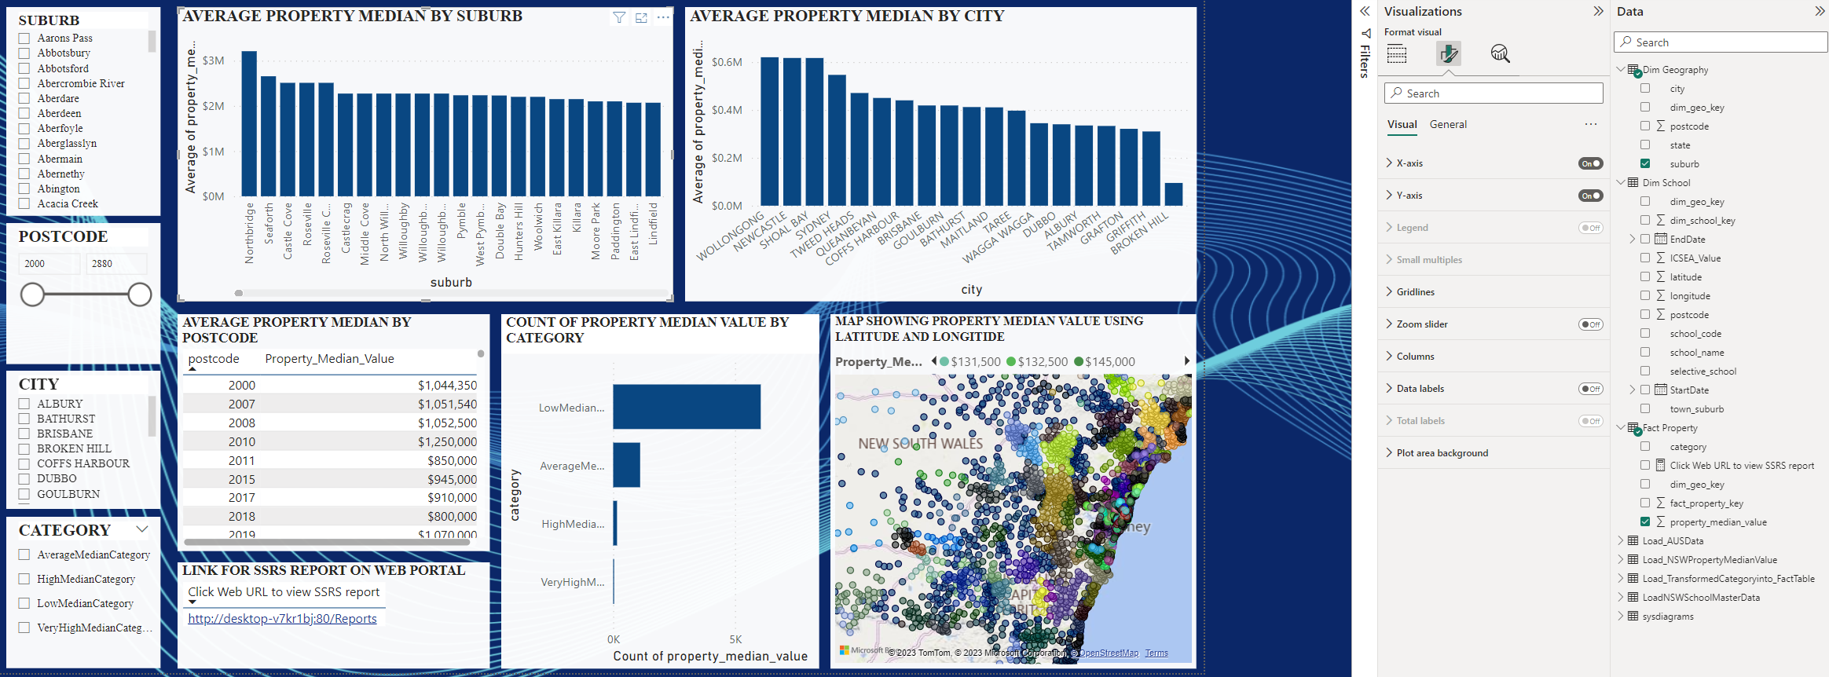
Create a link in Power BI report, and when users click the link, it will jump into the browser and open the above SSRS report

Slide 8
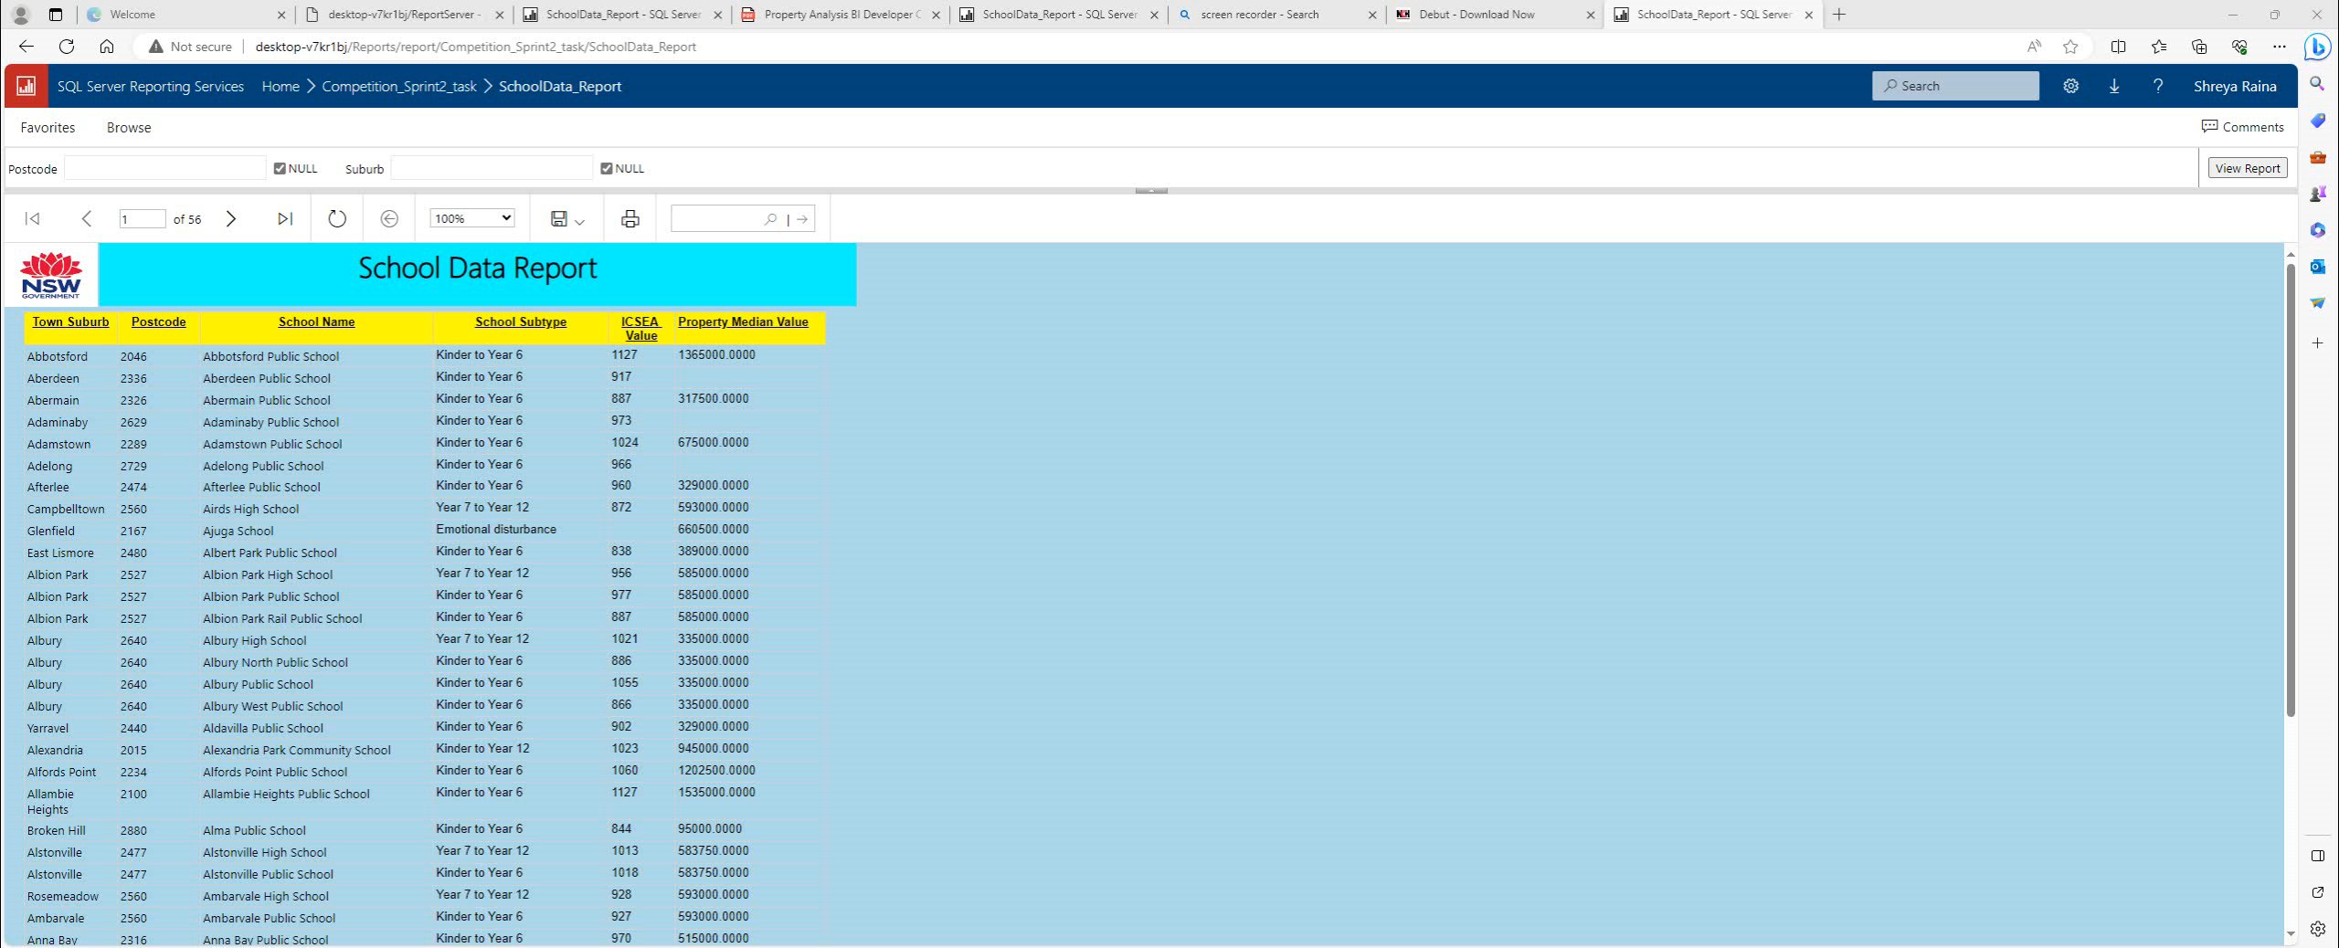
Click on the web portal link to open the SSRS report

Slide 9
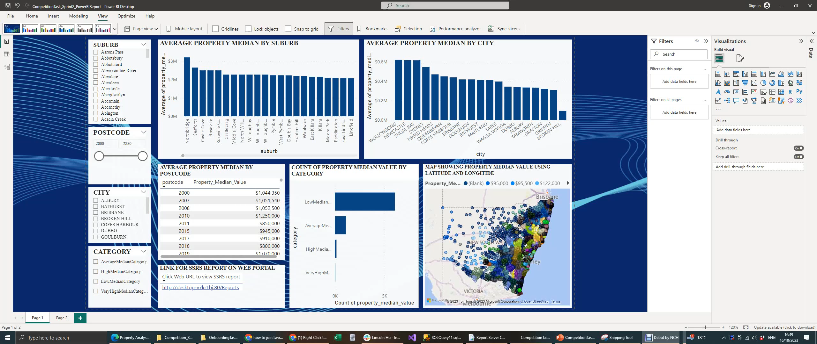
Using Drill function in Power BI

